Slide 1



Building, Testing, and Releasing
The Importance of Continuous Delivery
Bob Walker - Field CTO at Octopus Deploy
@bobjwalker
bob.walker@octopus.com
@bobjwalker

Slide 2
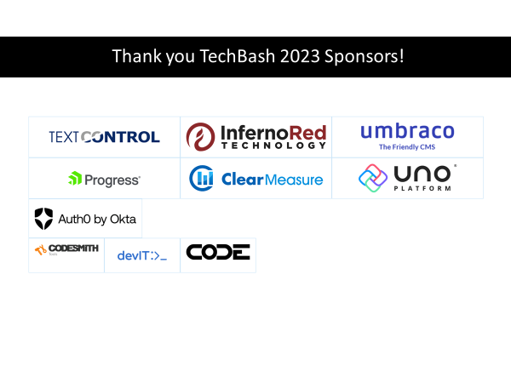

Slide 3

Bob Walker
Field CTO
Octonaut since 2018
@bobjwalker
bob.walker@octopus.com
@bobjwalker

Slide 4
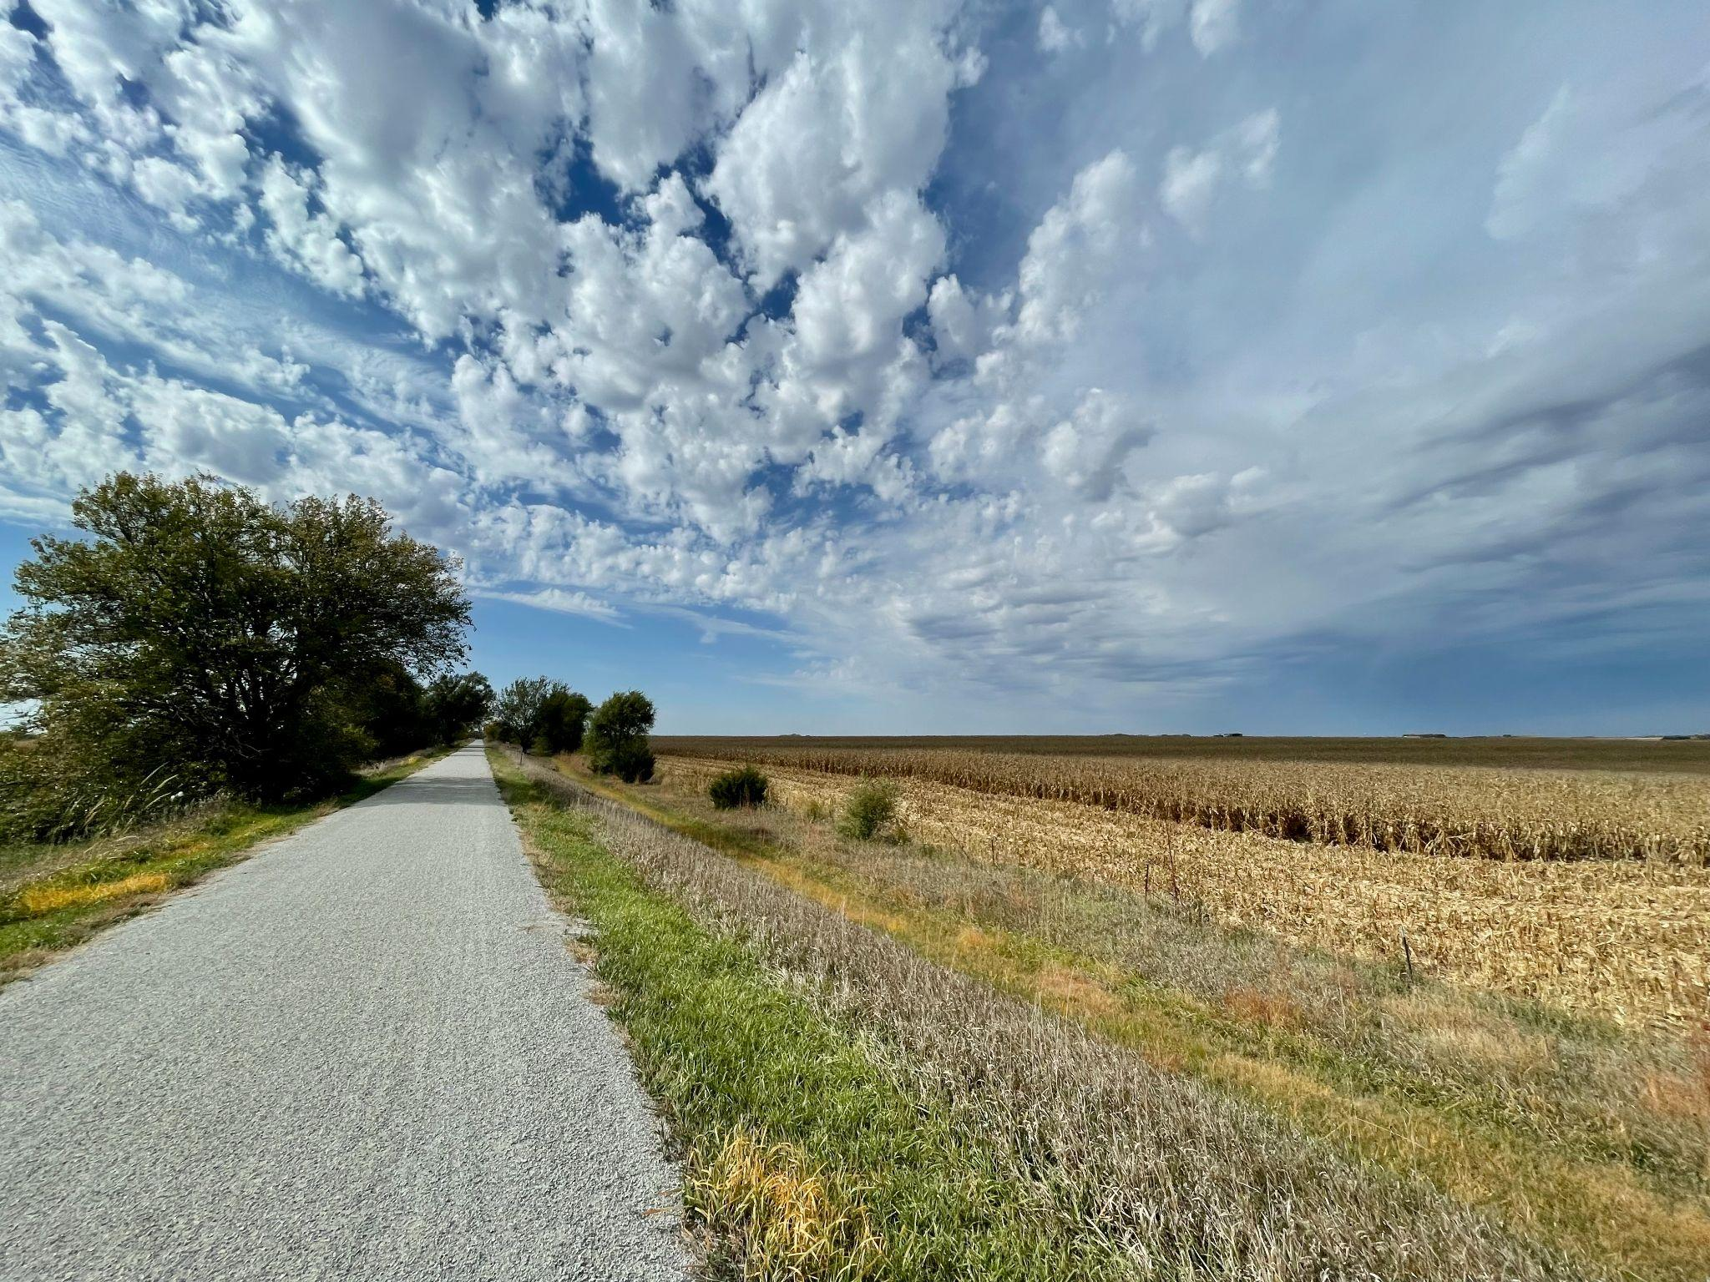
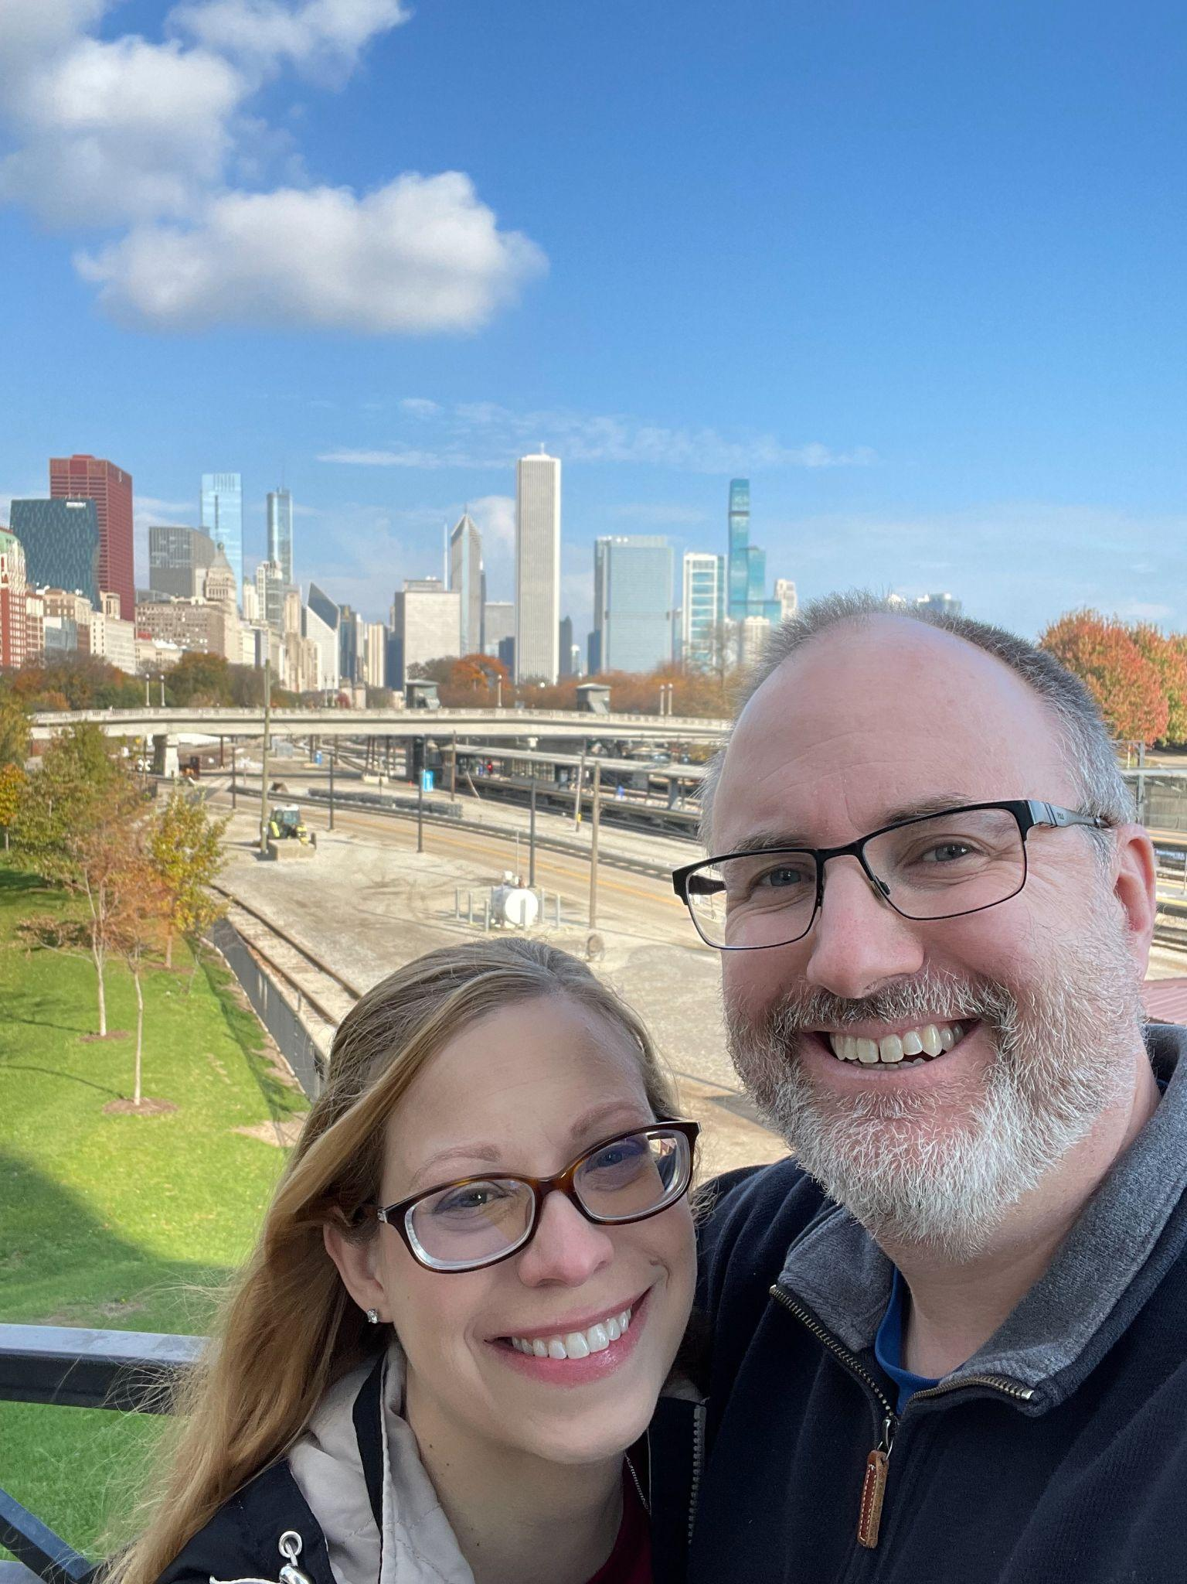
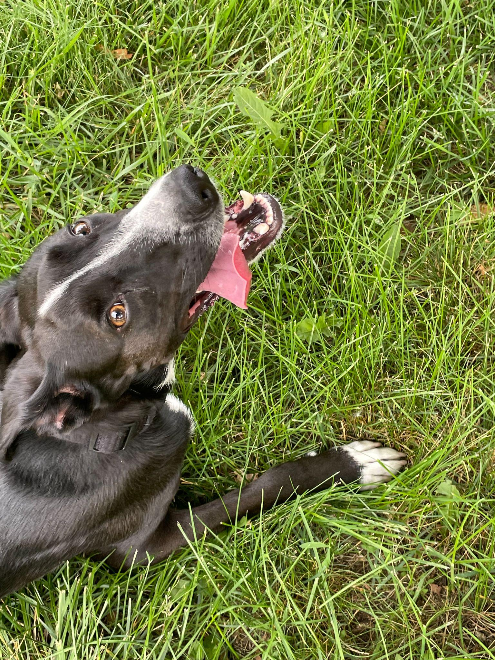
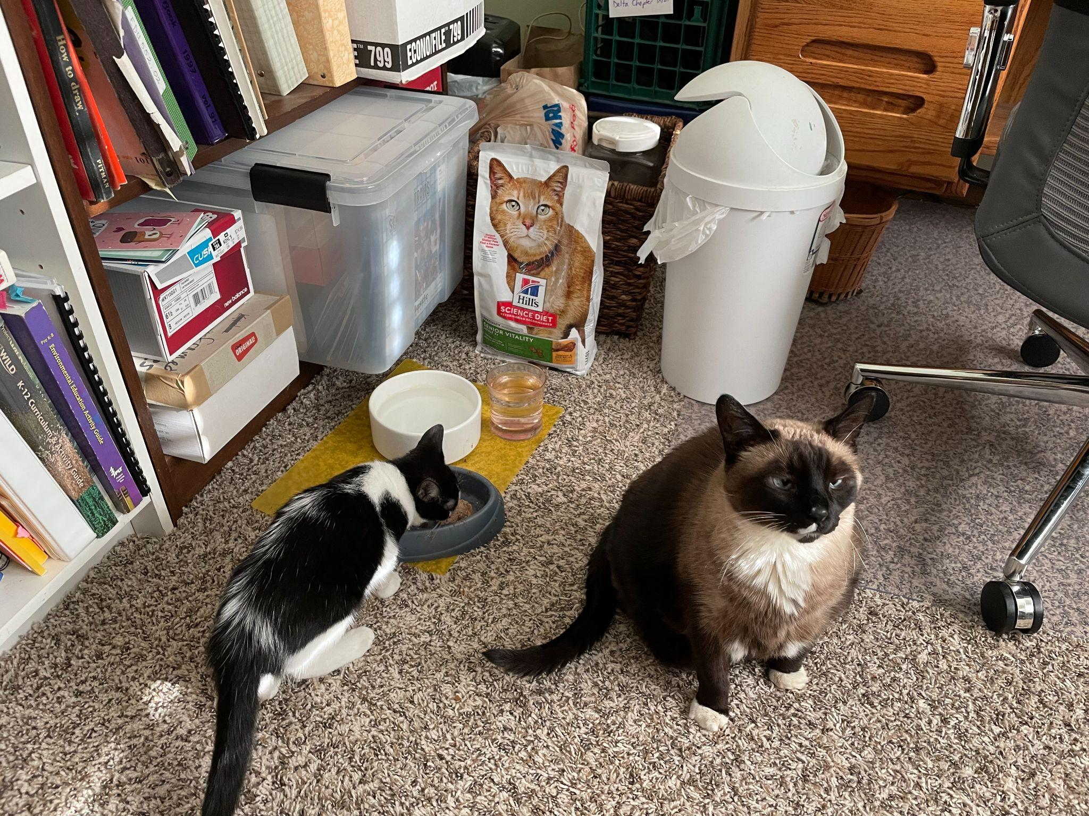

Slide 5







Slide 6




Slide 7
Quarterly to weekly deployments

Slide 8
2+ hours to 15 minutes

Slide 9
60%
All Releases required an emergency fix the next day

Slide 10
0%
All Releases required an emergency fix the next day

Slide 11


Slide 12
Outline
Importance of Continuous Delivery
Starting Point
Collaboration
Changes and Results
Lessons Learned
Getting Started Tips

Slide 13
Importance of Continuous Delivery

Slide 14

Why I’m telling you this story…

Slide 15
Continuous Delivery
Get changes into production, or into the hands of users,
safely and quickly in a sustainable way. - continuousdelivery.com

Slide 16
Benefits
Low-risk releases
Faster time to market
Higher Quality
Lower Costs
Better Products
Happier Teams

Slide 17
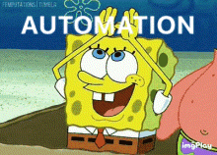
Automation is required

Slide 18

Don’t automate a terrible process

Slide 19
Starting Point

Slide 20

Boiled Frog
Image Source: https://en.wikipedia.org/wiki/Boiling_frog

Slide 21

Two Hour Deployments

Slide 22
60%
All Releases required an emergency fix the next day

Slide 23
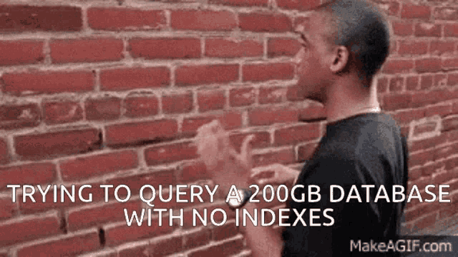
Pick on the database deployment process

Slide 24

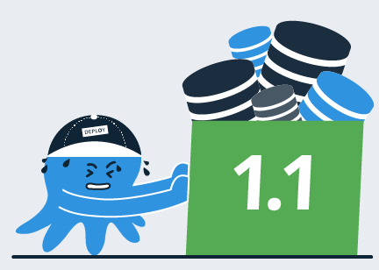
Change process
I’ve added a column to tbl_creditrequest
Cool, did you regen the sprocs?
Yeah, and I updated sp_SearchActiveCreditRequests too
I’ve added it to the list, thanks for letting me know
Developer
Database Developer

Slide 25
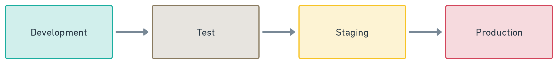
Desired Delivery Pipeline

Slide 26
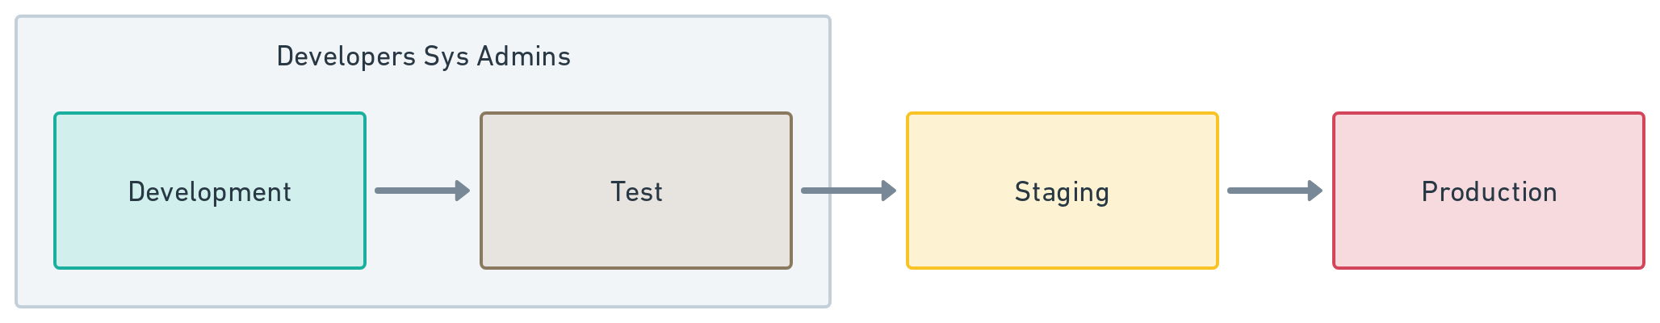
Actual Delivery Pipeline

Slide 27
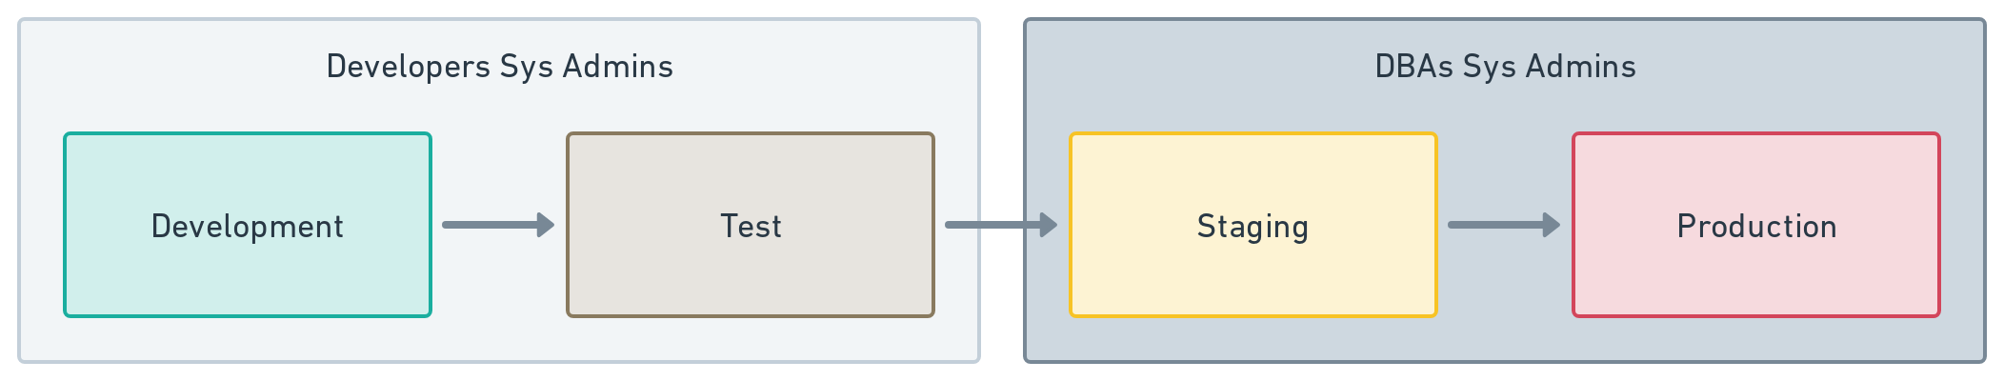
Actual Delivery Pipeline

Slide 28
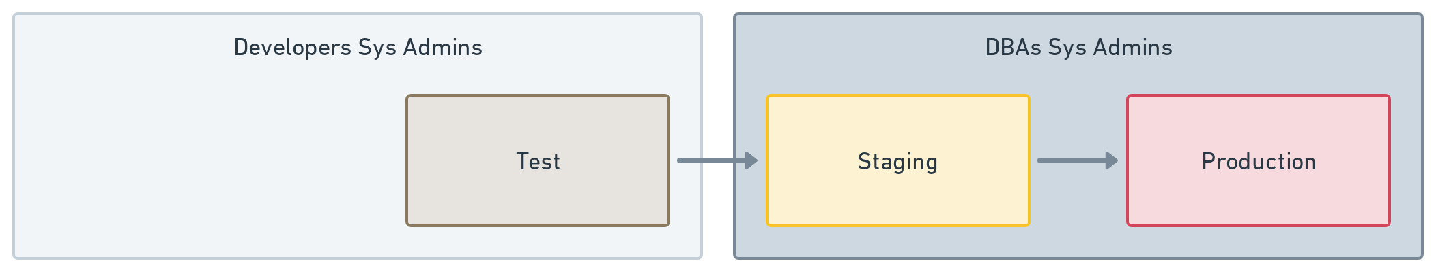
Actual Delivery Pipeline

Slide 29

Actual Delivery Pipeline

Slide 30
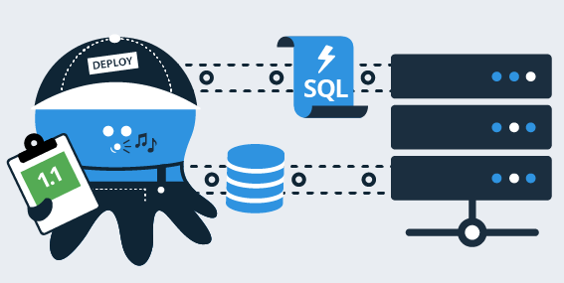
Production Deployment Prep
I’ve generated the delta files from staging. Please run it from [x] location
No problem, do you mind adding it to the deployment plan?
Can do. I’ll add a note about the script order, it’s critical today.
Thanks, I noticed that when we went to staging.
Database Developer
DBA

Slide 31
Production Deployment
Go ahead and run the scripts in the deployment plan.
I’ve already started…I’m getting an error on the second script.
Hmm, that’s a change from the developer. They’re telling me to try again.
Okay…here goes nothing.
Database Developer
DBA

Slide 32
Summary of Flaws
The delivered deployment artifacts were unreliable
Developers changing Test directly
Unfinished changes make it to Production
Manual comparison and generation of delta scripts
Delta scripts regenerated for Staging and Production
Dismissive of feedback from Operations
“That deployment last night took three hours”
“Each team delivers their scripts a different way”
“At times, I feel like an F5 monkey, all I do is run scripts from developers”
“You just generated that script? How do you know it will work?”
“How was I supposed to know the scripts must be run in a specific order?”

Slide 33
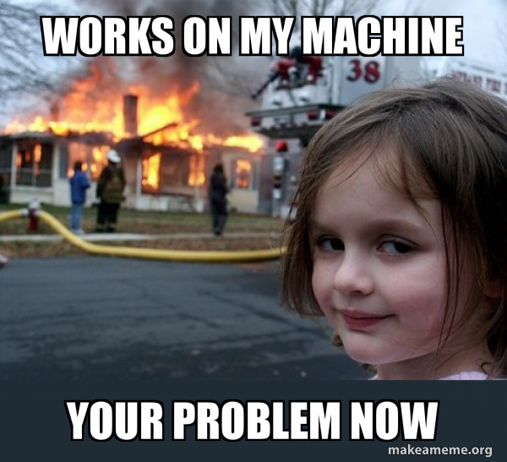
How Operations Viewed Development Teams

Slide 34

Defense Mechanisms
Manually review all delta scripts
Only operations can perform deployments to staging and production
Once a quarter deployments per application
Change approval boards
Image Source: https://www.pluggedin.com/movie-reviews/osmosisjones/

Slide 35
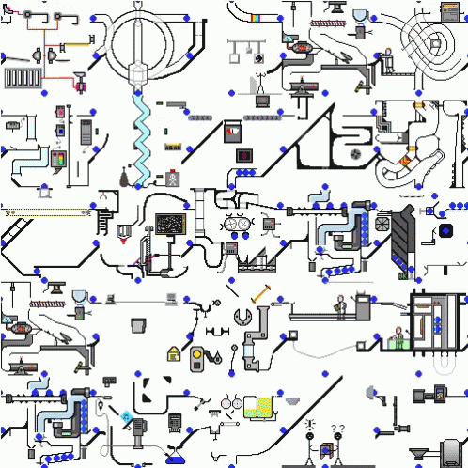
Amalgamation of reactions to mistakes

Slide 36
Solving the wrong problem

Slide 37
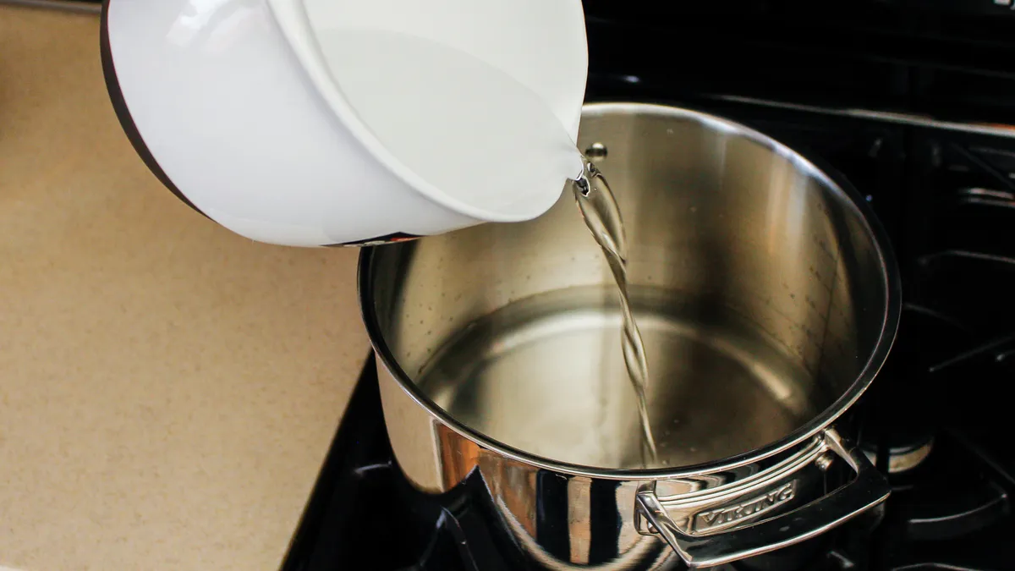
Boiled Frog
Image Source: https://en.wikipedia.org/wiki/Boiling_frog and https://www.cnet.com/home/kitchen-and-household/how-to-make-distilled-water-at-home-for-free-5-easy-steps-for-clean-water/

Slide 38
Automate delta script generation and execution
CLI tooling
Test to Staging
Staging to Production
Powershell
Create folders
Copy files to folders
Send email notifications to DBAs
Execution
DBAs run a single “control script”

Slide 39
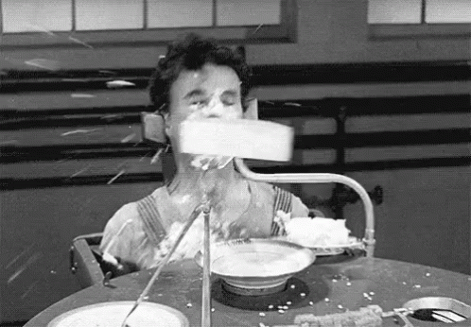
Automation won’t fix a terrible process

Slide 40
Are we solving the right problem?
Why are we comparing Staging to Production?
Why do we need to send scripts to DBAs?
Do the DBAs understand the scripts / applications?
Is reviewing right before Production the right time?
Is this the best use of a DBA’s time?

Slide 41
Collaboration

Slide 42
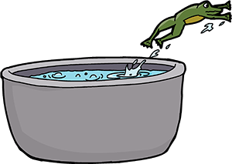
Boiled Frog
Image Source: https://en.wikipedia.org/wiki/Boiling_frog and https://hrprofessionalsmagazine.com/2020/01/30/dont-become-a-boiled-frog-becoming-more-agile/

Slide 43
Everyone: our current process is unsustainable

Slide 44
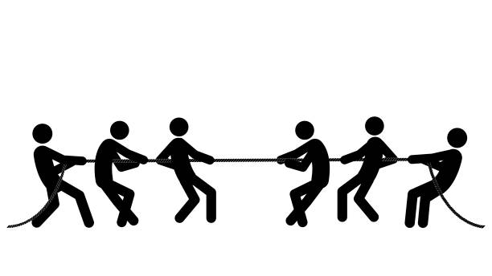
Developers
New Features
Operations
Keeping Production Up

Slide 45
Organizational Silos and Distrust

Slide 46
Focus on solving Database Deployments

Slide 47

Two-day meeting
Representatives
DBA
Database Architect
Lead Developer
Database Developer
Manager
Identify key business rules to follow
Key Metrics
Design process and responsibilities
Image Source: https://www.airswift.com/blog/five-ways-to-improve-training-and-development-in-the-workplace

Slide 48
Business Rules
Changes must be reviewed
Syntactically correct
Company standards
Best practices
Review is done by someone who didn’t make the change
Truth center for changes
Auditable
Link to business change request
Consistent process across all environments

Slide 49
Key Metrics
2+ Hour Deployments -> Deployment Time
Quarterly Release Cadence -> Deployment Frequency
60% Emergency Fix the next day -> Post Deployment Emergency Fixes or “Failure Rate”

Slide 50

DORA Metrics
Deployment Frequency
Lead Time To Changes
Mean Time To Recover
Change Failure Rate

Slide 51
Changes and Results

Slide 52
Process Changes
Put the database schema into source control
Require local database development
All changes made on a branch
Trigger build on each branch check-in
Always verify schema during the build process
Pull Requests to approve changes

Slide 53






Slide 54
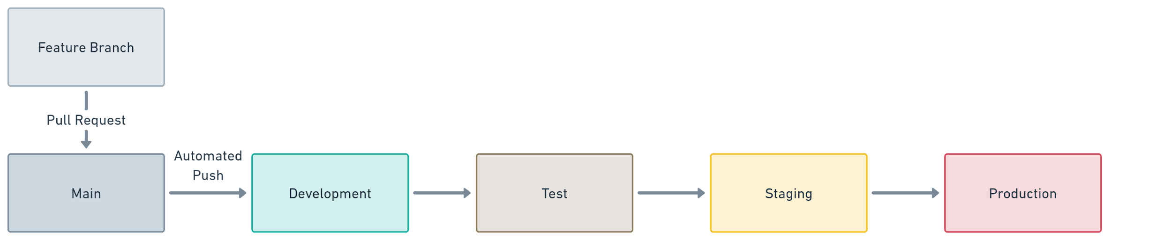
v1 Delivery Pipeline

Slide 55
Benefits
Build once, deploy everywhere
No changes can be merged into main without approval
Prior to merging the build will perform verification of changes
No half-finished changes will make it to the main branch
Only scripts in source control will go to Production
Any changes made outside of the process will most likely be overwritten
Every script will be run at least once per environment
Promoted in the correct order
Minimize chance of surprises in Production

Slide 56
Business Rules
Changes must be reviewed
Syntactically correct
Company standards
Best practices
Review is done by someone who didn’t make the change
Truth center for changes
Auditable
Link to business change request
Consistent process across all environments

Slide 57
Business Rules
Changes must be reviewed - Done during PR prior to main
Syntactically correct
Company standards
Best practices
Review is done by someone who didn’t make the change - enforced via PR
Truth center for changes - Git
Auditable
Link to business change request
Consistent process across all environments - Build and Deployment Tooling

Slide 58
Key Metrics

Slide 59
120 Minute Deployment

Slide 60

100 Minute Deployment

Slide 61
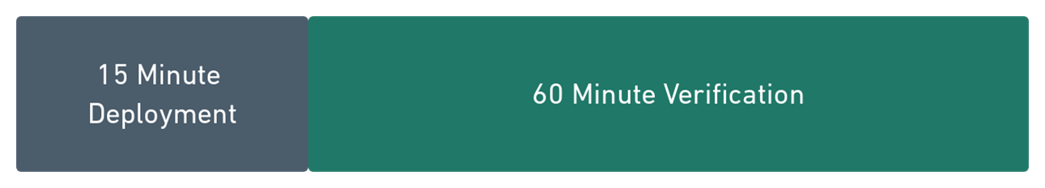
75 Minute Deployment

Slide 62
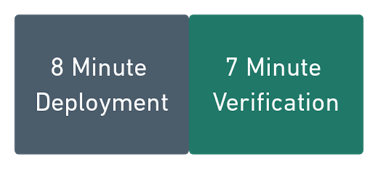
15 Minute Deployment

Slide 63
0%
All Releases required an emergency fix the next day

Slide 64
Lessons Learned

Slide 65
People are the biggest hurdle,
not technology

Slide 66
Meet face to face over async communications

Slide 67
Listen to feedback and adjust

Slide 68
Adjustments
No process is static
New technologies
New techniques
Learn and understand tools better

Slide 69
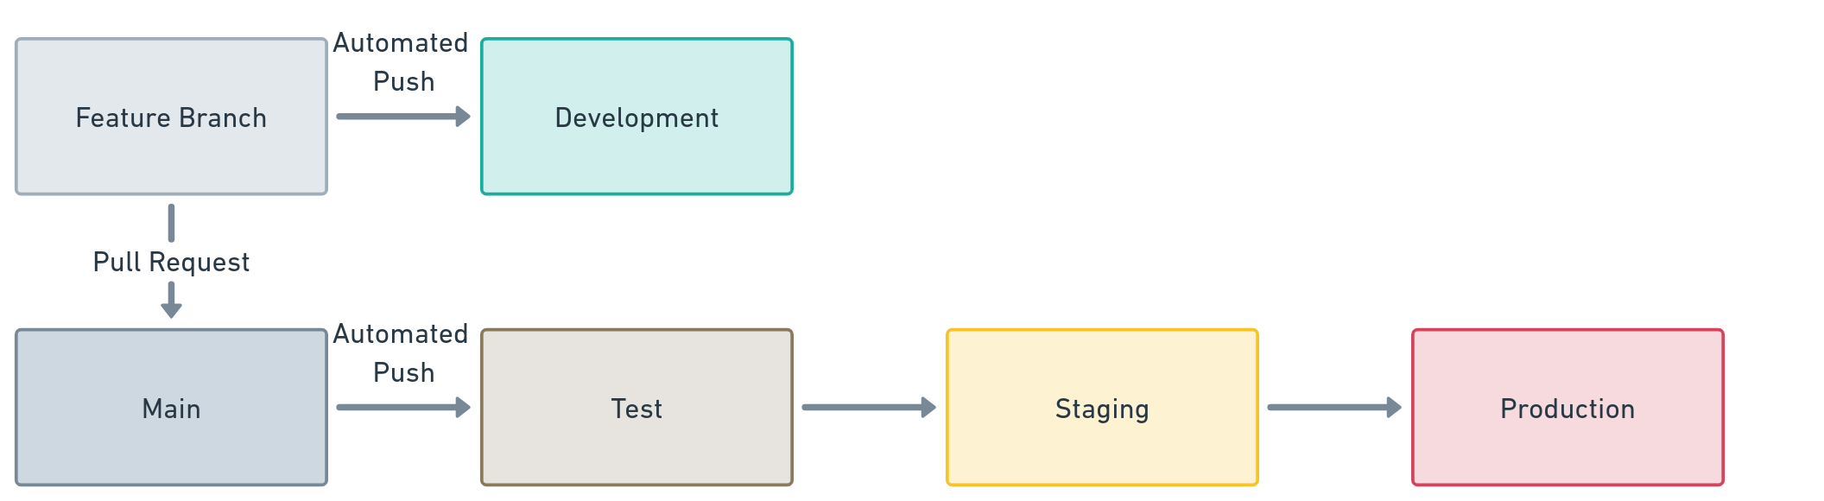
v2 Delivery Pipeline

Slide 70
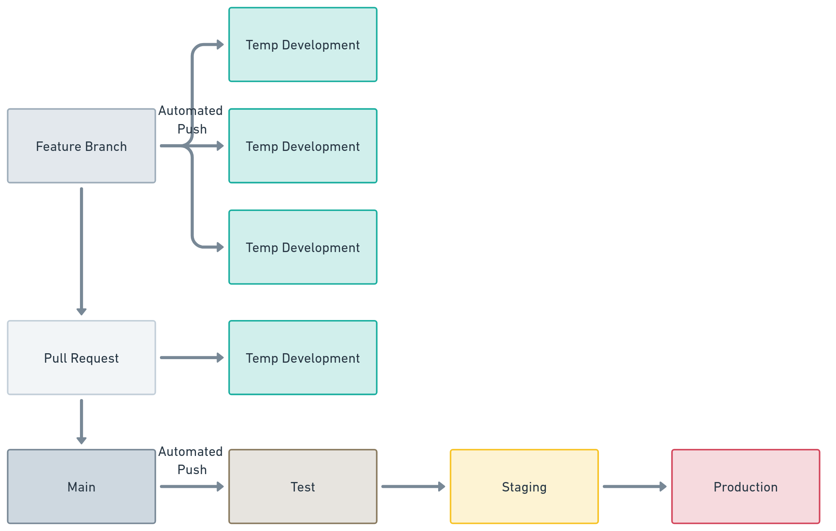
v3 Delivery Pipeline

Slide 71
To do it right, you need one or more people to focus on these problems
all day, every day.

Slide 72
Careful with the work groups
“School of Software Delivery”
Developers (like me) get very passionate about their tooling
We literally spent weeks arguing over TeamCity vs. Jenkins
Leadership got fed up with us and choose Azure DevOps

Slide 73
Getting Started

Slide 74
Single Team
Avoid too many cooks in the kitchen
Option #1
One person chosen from each job role
Each person brings their experience and concerns
Build out a list of priorities
Good getting started option
Option #2
Platform Engineers
Centralized team used to collaborate between all roles
Learn the tooling and build the processes

Slide 75
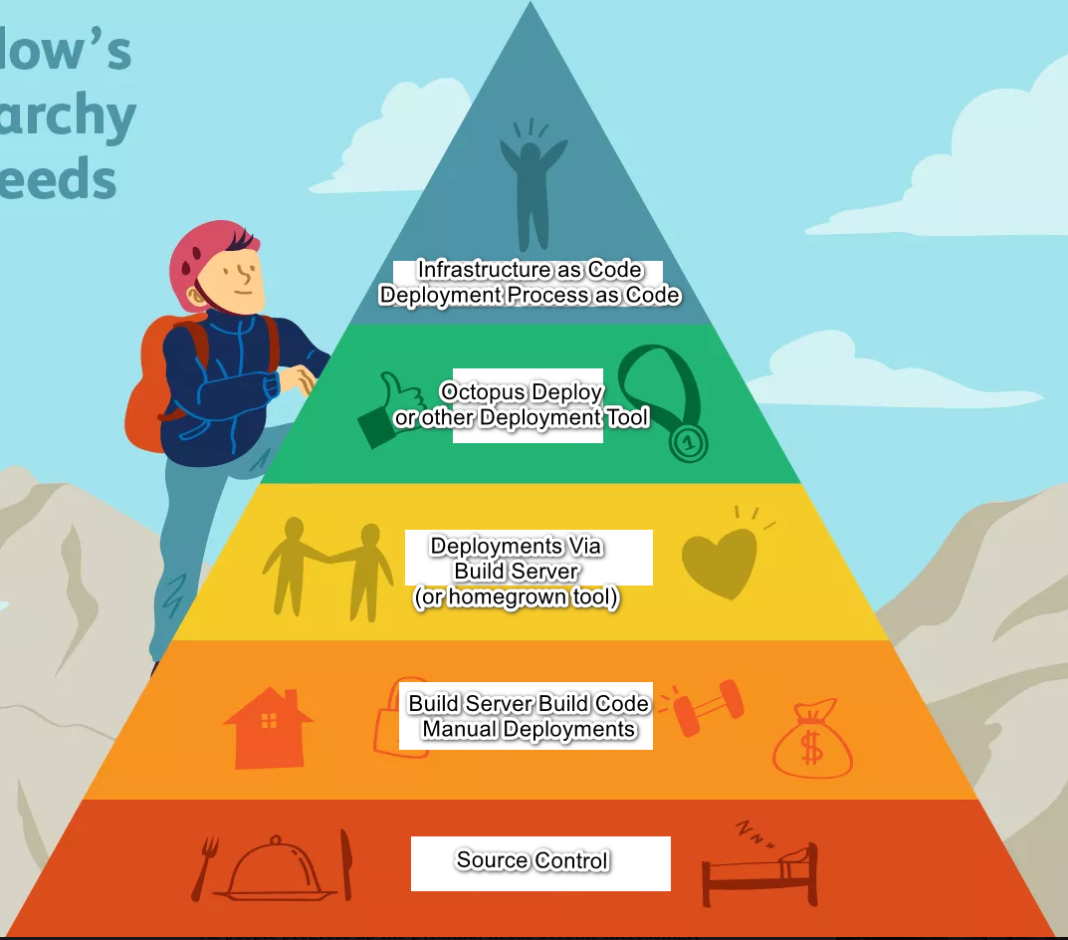
Think of your priorities as a triangle

Slide 76
Learn the tooling

Slide 77
Collaborate with all the other roles

Slide 78
Be a servant coach

Slide 79
Build that trust

Slide 80
Repeatedly stress you are NOT attempting to replace anyone with automation

Slide 81
Building Trust
Be as transparent as possible
Articulate why a problem needs to be solved
Post regular updates
Celebrate wins
Acknowledge setbacks

Slide 82
High trust is needed for
Continuous Delivery

Slide 83
Deployment Frequency and Changesets
“Trust me, bro” doesn’t work
Larger changesets = Longer Deployment Time
Comfortable deploying more frequently
Once a quarter became once every eight weeks
Once every eight weeks became once a month
Once a month became once a fortnight
Once a fortnight became once a week
Smaller and smaller changesets

Slide 84
Summary
Continuous Delivery is critical
Automation is key to Continuous Delivery
Don’t try to circumvent a team with automation
Break down the silos and build trust
Collaborate and iterate on the process

Slide 85

Thank you!
Bob Walker - Field CTO at Octopus Deploy
@bobjwalker
bob.walker@octopus.com
@bobjwalker

